Slide 1

Antenatal Class 6
Physiotherapy
Notes:
Welcome to the last of your AN Classes
Lots of general info, take note of things most applicable to you
In chat please put name, how many weeks pregnant, first baby/previous delivery type

Slide 2

Overview
Postnatal Recovery
Baby Handling and Development
Labour (Positions, Breathing, Pushing)
Perineal Massage
Notes:
If you are having al elective c/s, you don’t need to stay for the labour and perineal massage section but please do stay if you would like.

Slide 3
Postnatal Recovery
Pain Relief
Rest
Ice
Compression
Exercises
Notes:
Everyone is different – don’t compare.
PRICE for early days

Slide 4

Exercises
Pelvic Floor Muscle Exercises (3 times a day)
  Long Holds 10seconds x10
  Short Holds x10
  The Knack
Deep Abdominal Muscle Exercises
  Trans Abs Exercise in lying
  Knee Rolls & Pelvic Tilts

Slide 5
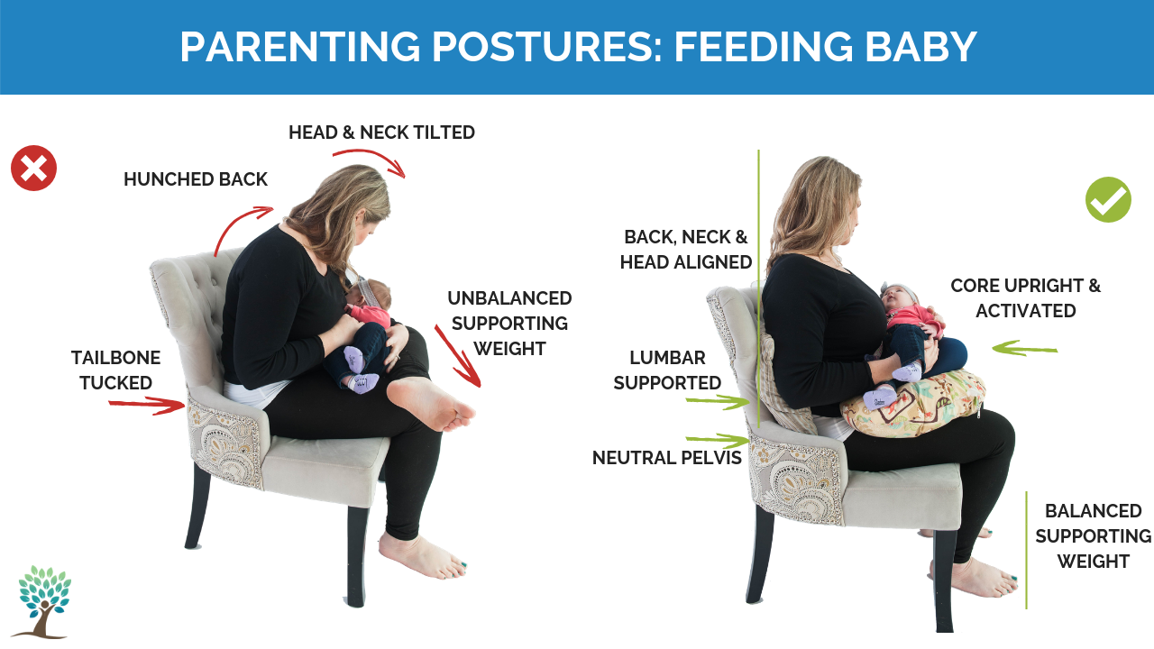
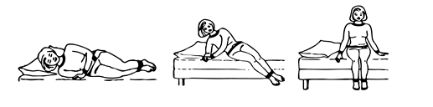
Posture

Slide 6
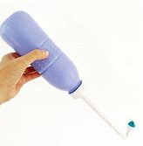
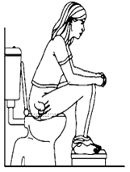
Healthy Bladder & Bowel habits
Bladder
  Drink enough fluids! 1.5-2L if bottle feeding, 2-2.5L if breast feeding
  Take your time and fully sit on the toilet
  Peri squeeze bottle
Bowels
  Avoid constipation: Enough Fluids & high fibre foods
  Toilet position
  Laxatives
Notes:
Bladder Extras:
Perineal squeeze bottle – can buy in boots , good for cleaning if theres a tear and also if its stingy urinating
Can be lots of blood
Teas/coffee/fizzy drinks can irritate bladder & increase feelings of urgency
Bowel Extras:
Examples of high fibre foods
Laxatives routinely given for larger tears, but if constipated ask midwives
PN follow midwifes instructions:
If you end up having an instrumental delivery or c/s, you normally have a catheter put in after for 24hrs. If you do have a catheter, you will be asked to measure your first 2 voids to ensure bladder is filling/emptying ok

Slide 7
Postnatally
Physio will see you on ward
You have 6 months to self refer into Physiotherapy for any pelvic floor issues or you can self refer at any time during your pregnancy
Postnatal online class
physiotherapy@rotunda.ie
018171787

Slide 8

Baby Handling and Development
Tummy Time
Head preference
Equipment

Slide 9
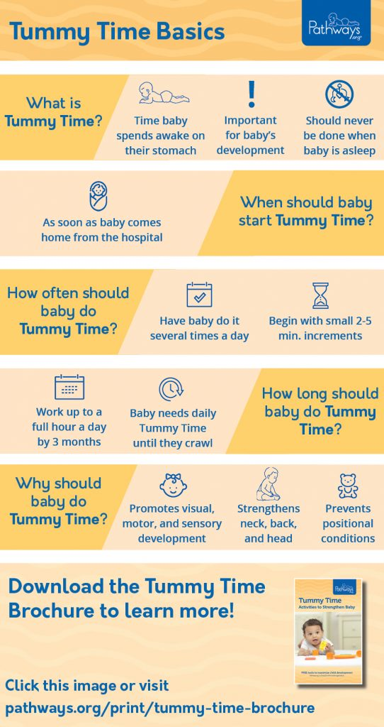
Tummy Time
Pathways.org

Slide 10
Head preference
Encourage both sides
  Feed on different sides
  Switch ends/direction of cot
Sleep
  A - Alone
  B – on their Back
  C – in safe Cot

Slide 11
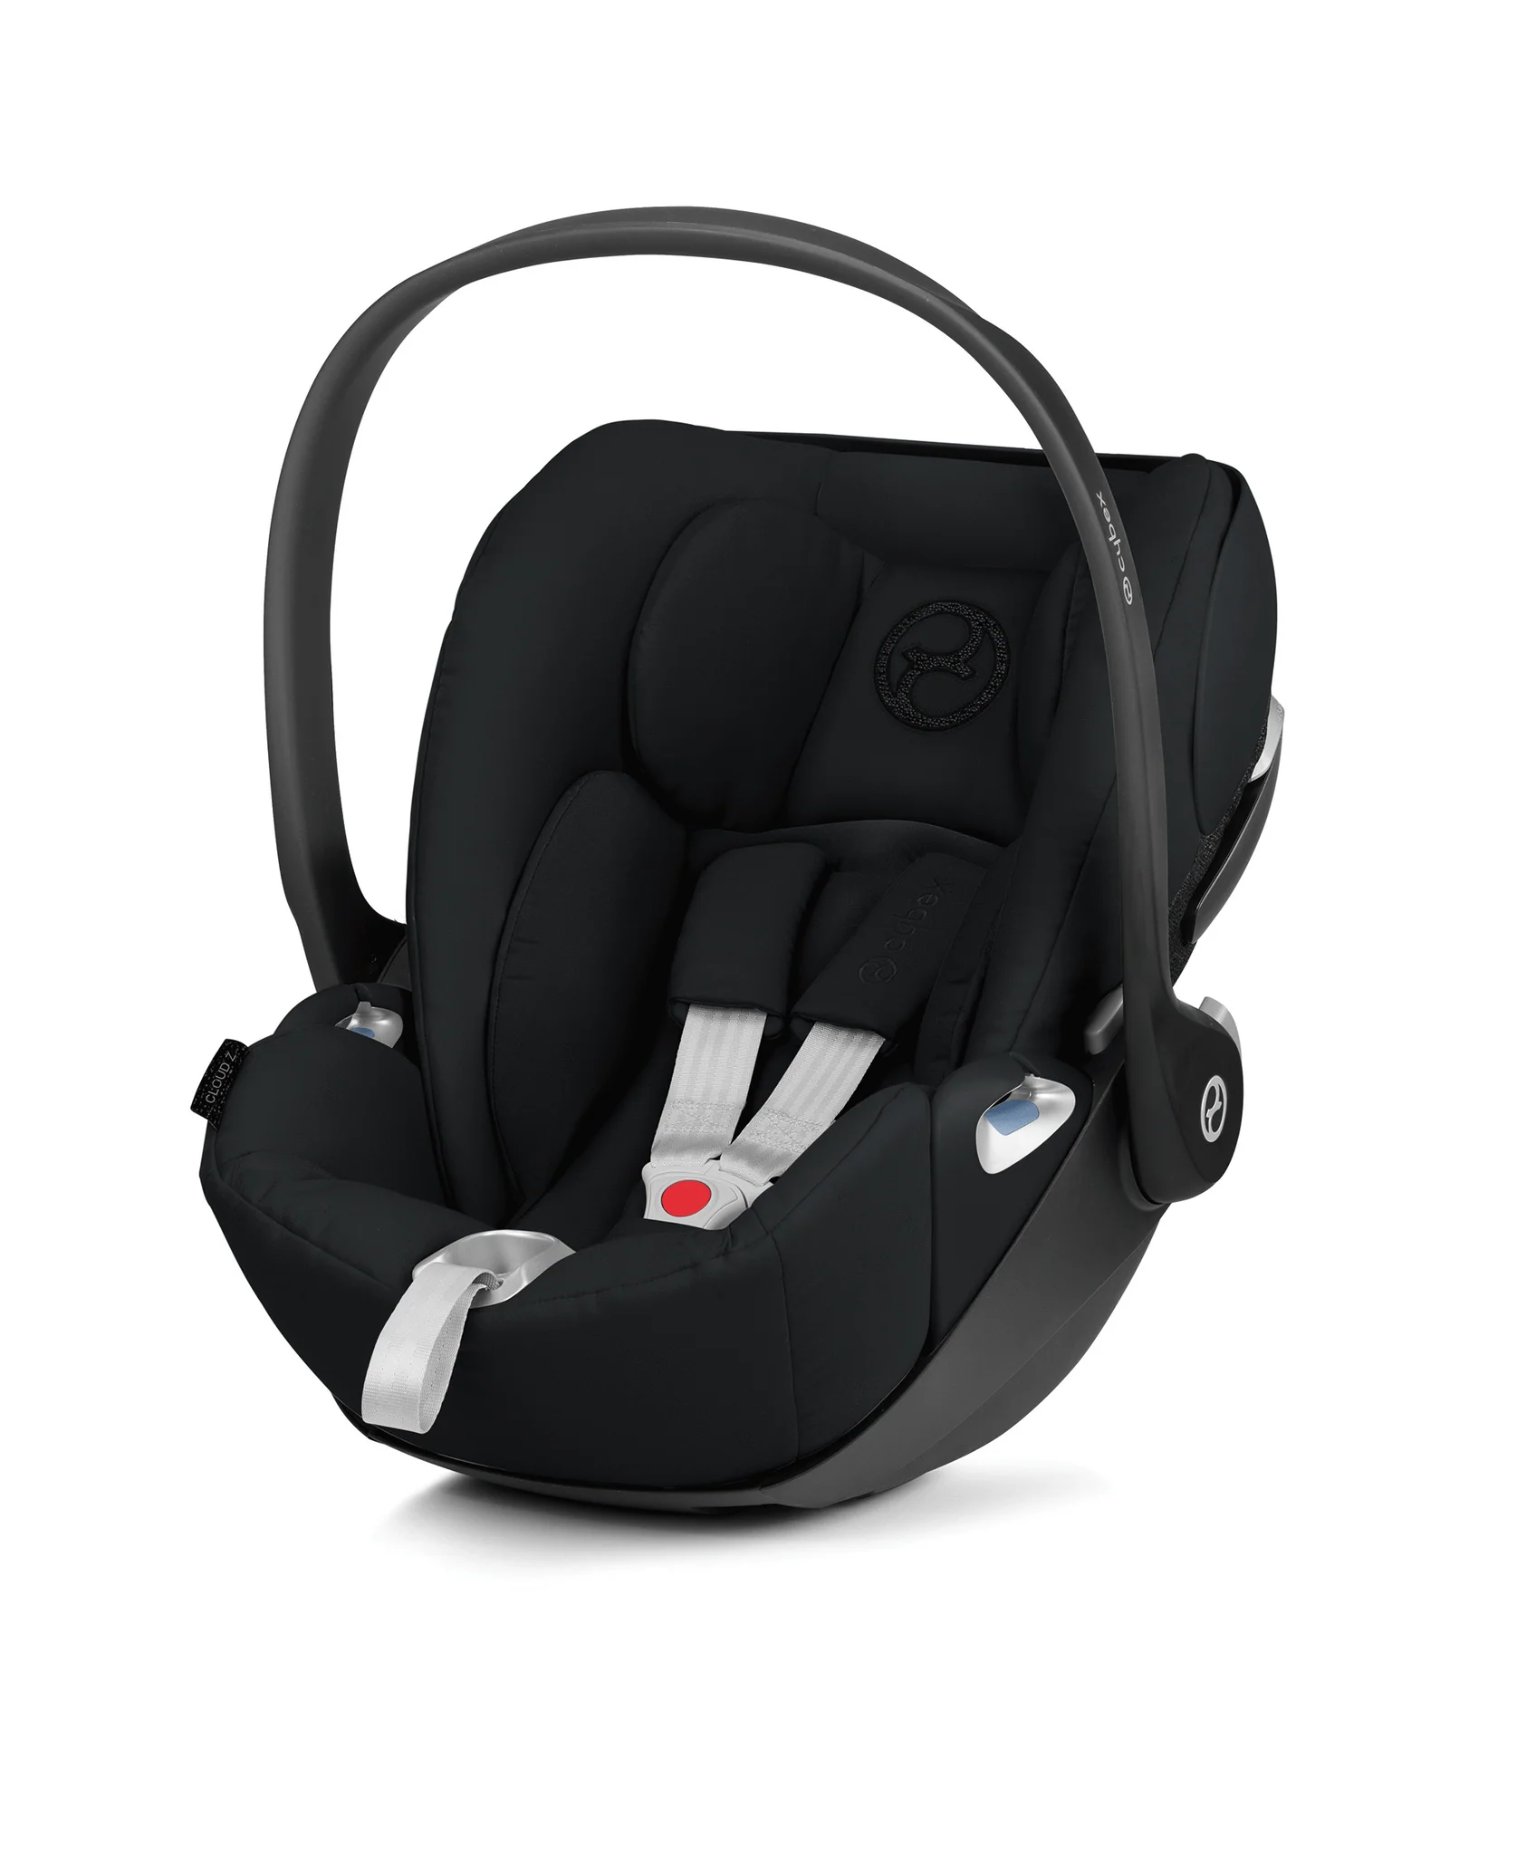
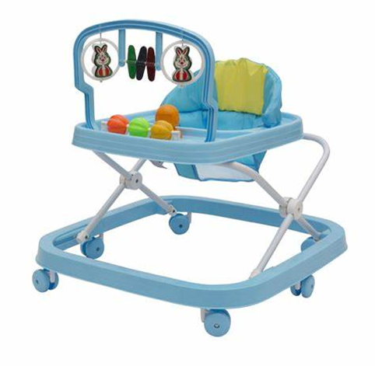
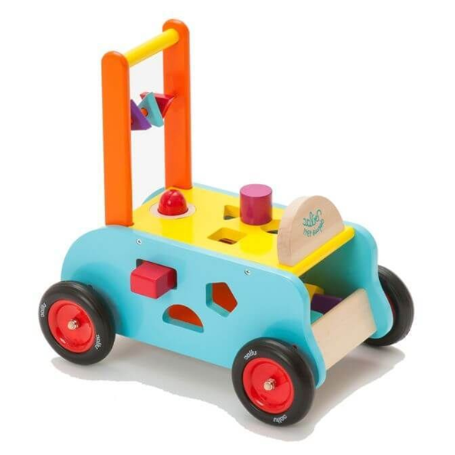

Equipment

Slide 12
Stages of Labour
Stage 1 – Cervix Dilation (0-10cm)
  Longest stage
  On average 10-12hrs first time
Stage 2 – Pushing stage/Delivery of baby
  On average 1-2hrs first time
Stage 3 – Placenta Delivery

Slide 13
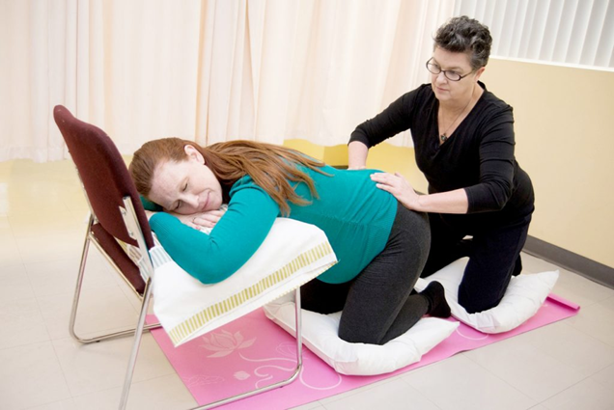
Stage 1: Between Contractions
Yoga stretches
Short walks
Lie down
Gym ball
Shower/bath
Hot water bottle on back/ice on front
Massage
Light easily digestible food
Meditation/ Visualisation
Music
Notes:
Massage:
Firm descent global pressure
Using heel of hands at lower back/gluts
Practice before!
https://www.youtube.com/watch?v=xx1cH08ca-k

Slide 14
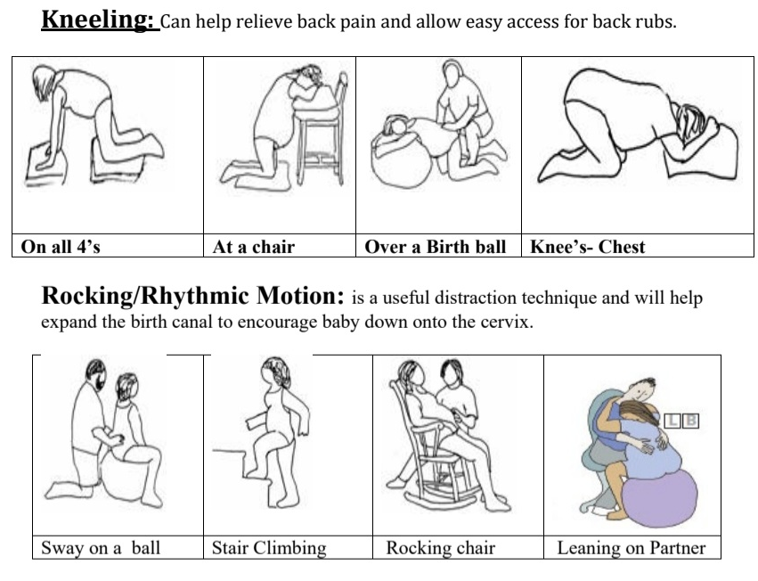
Stage 1: Positions
Standing
Notes:
U - upright
F - forward
O - open

Slide 15
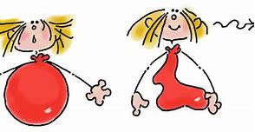
Stage 1: Breathing
Deep belly breathing
  Breath into tummy, let it soften as you exhale
  Double exhale to inhale eg In for 3, out for 6
  Match breath to intensity of contraction
Puff puff blow
  As contractions get bigger and longer
Sigh it out- after contraction
  Sigh of relief
  Lets your body know its done, releases tension
Panting
  If you feel like pushing but not medically advised to

Slide 16
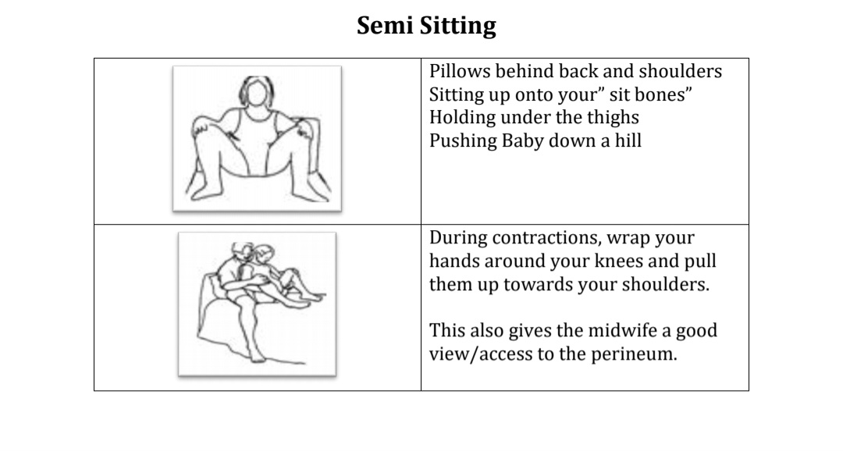
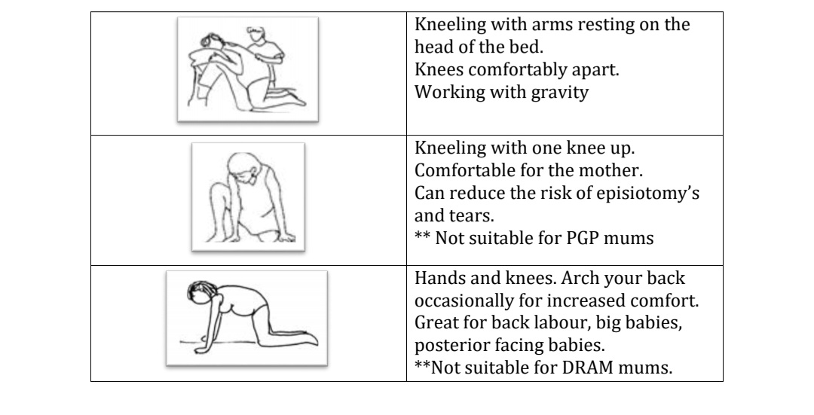
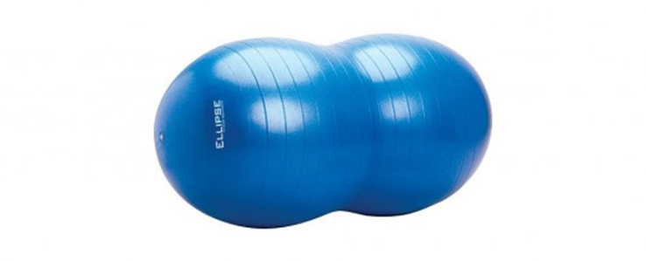
Stage 2: Positions

Slide 17
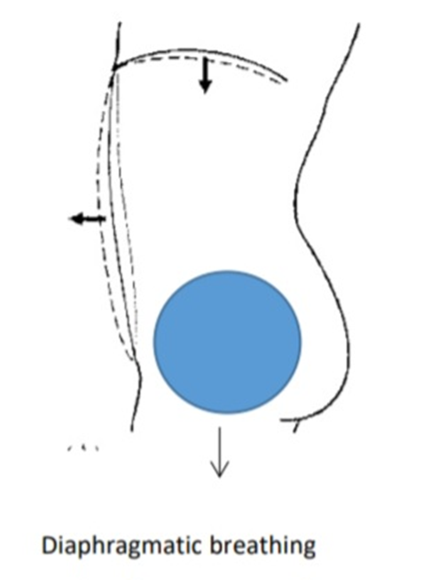
Stage 2: How to push
Aiming for 2-3 pushes per contraction
Breath in deeply allowing tummy to expand
On breath out keep tummy WIDE
Push towards back passage
Do not push on tight pelvic floor
Make noise - Vowel sounds eg O, E, Moo
Panting – to allow perineum to stretch when babies head is crowning
Rest between contractions

Slide 18
Stage 3
Delivery of the placenta
May need an injection
May have to give a slight push

Slide 19
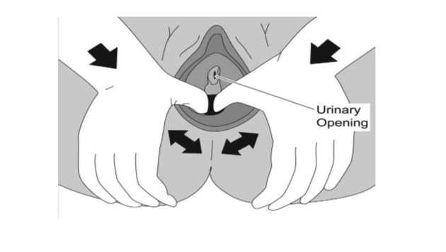
Perineal Massage
Reduced risk of tearing and episiotomy
In last 5-6 weeks of pregnancy
Use of a lubricant e.g olive oil, vitamin E oil, almond oil, K-Y jelly
Use a finger/thumb on lower U part of vaginal entrance (4, 6, 8 o’clock)
Burning sensation that should ease as weeks progress
https://www.youtube.com/watch?v=3hN0kxAj-UU

Slide 20
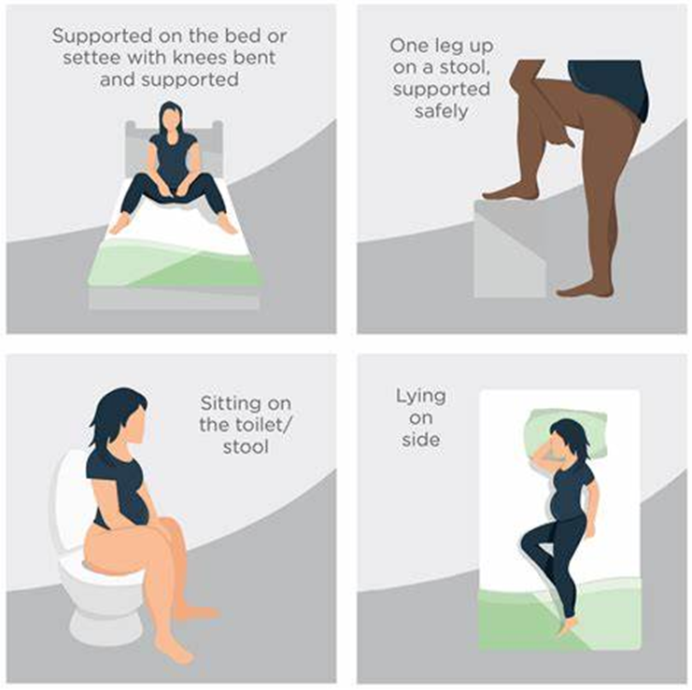
Perineal Massage

Slide 21

Relaxation
Regular relaxation will help you during pregnancy and labour. It may also help you with the transition into parenthood.
Developing a relaxed state of mind in response to labour takes practice. Below are some tips to help you develop these skills in preparation:
Take time out for yourself every day
Deep/diaphragmatic breathing exercises
Meditation/body scan
Getting outside for a walk
Stay active, but rest when you need to
Ask for practical help from family or friends and be realistic about how much you can do

